Slide 1
14- Exercise

Slide 2
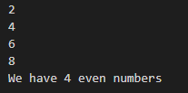
write a program to display the even numbers between 1 to 10.
You should see below result in terminal

Slide 3
Quick hint
call the range function with 1 and 10. Do not use the third argument which is called Step.
So basically, I want you to reiterate over all the numbers We've been 1 to 10. Check if each number is an even number and then printed on the terminal.

Slide 4


Slide 5
